Slide 1


NEXUS
Designed by AESIR 2012

Slide 2

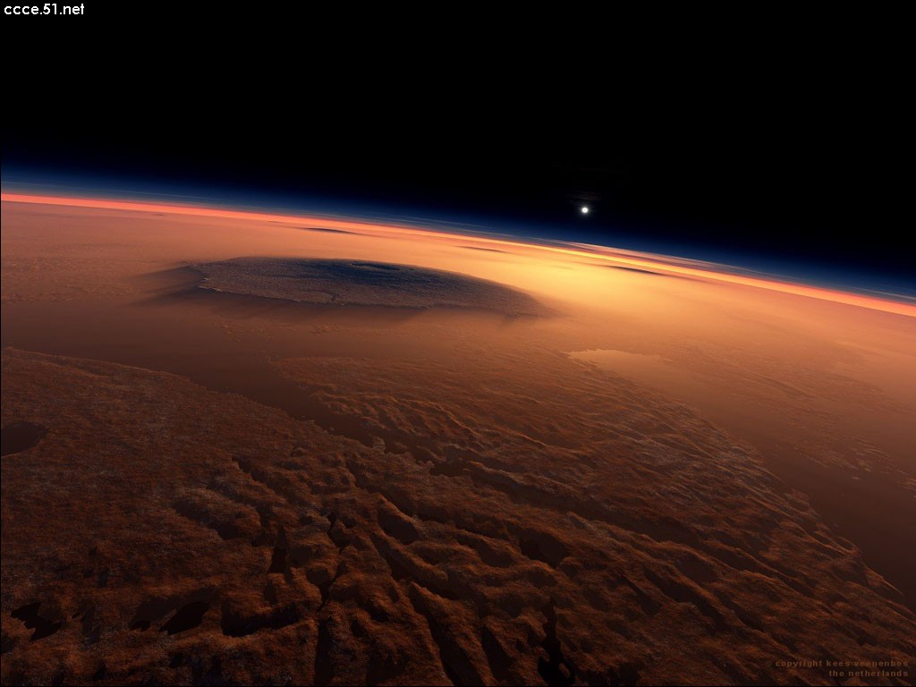
NEXUS
Copyright © AESIR 2012

Slide 3
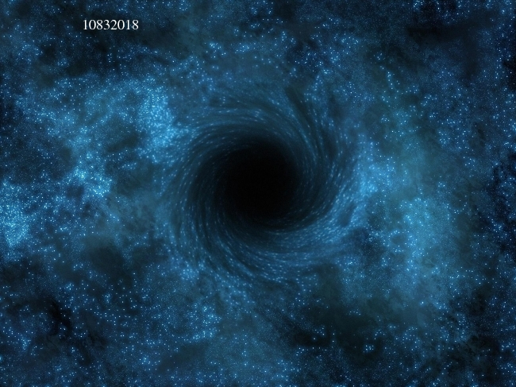
NEXUS
Copyright © ELFPRO 2015

